Slide 1

PEOPLE’S COMMITTEE OF DISTRICT 12
NGUYEN DU PRIMARY SCHOOL
WARMLY
WELCOME TO GRADE 4
Presented by Ms. Nguyệt

Slide 2



Song: Seasons in the sun
Family and Friends special edition– Grade 4

Slide 3

Unit 9
Family and Friends special edition– Grade 4
What’s the fastest animal in the world?
words
Lesson 1 :

Slide 4

CONTENT
Family and Friends special edition– Grade 4
1. Vocabulary
2. Story
3. Homework

Slide 5
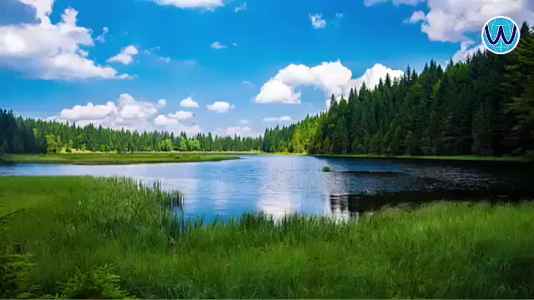
1. Vocabulary
Family and Friends special edition– Grade 4

Slide 6


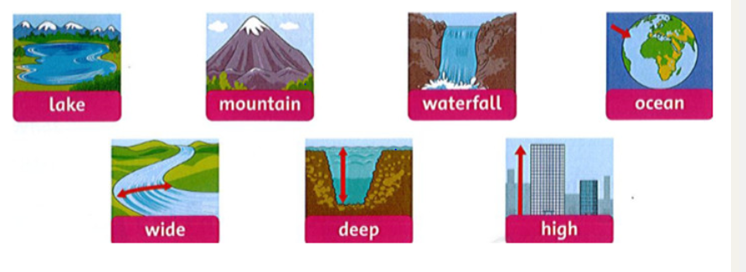
Listen and point
Family and Friends special edition– Grade 4

Slide 7
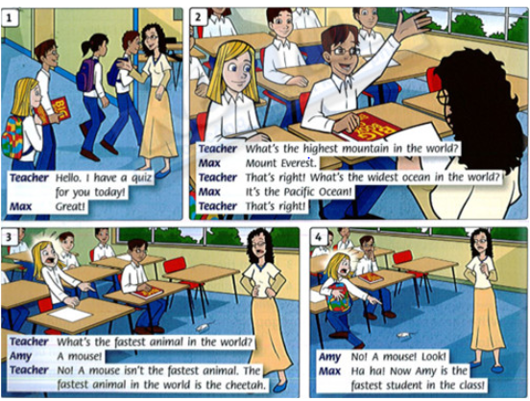
Story: Look
Family and Friends special edition– Grade 4

Slide 8

Answer the questions
Family and Friends special edition– Grade 4
1.
Where are the children?
They’ re at school.
2.
Who wants answer the teacher’s questions?
It’s Max.
3.
What does Amy see ?
She sees a mouse.
4.
What does she do?
She runs.

Slide 9
Listen and read:
Family and Friends special edition– Grade 4

Slide 10

Questions :
Family and Friends special edition– Grade 4
1
Why is Max happy?
Because he answers the teacher’s questions correctly .
2
Does Max know all the answers?
Yes, he does.
3
Why is Amy scared?
Because She sees a mouse.

Slide 11

1. Vocabulary
Family and Friends special edition– Grade 4
lake : hồ nước
mountain (n): núi
waterfall (n: thác nước
ocean (n): đại dương
wide (adj): rộng
deep(adj): sâu
high( adj): cao
- animals (n): con vật
quiz (n): câu đố
in the world: trên thế giới
That’s right!: đúng rồi!
cheetah(n): con báo

Slide 12
Family and Friends special edition– Grade 4
2. Copy word: each word 2 lines
3. Home work: Workbook, page 60.

Slide 13
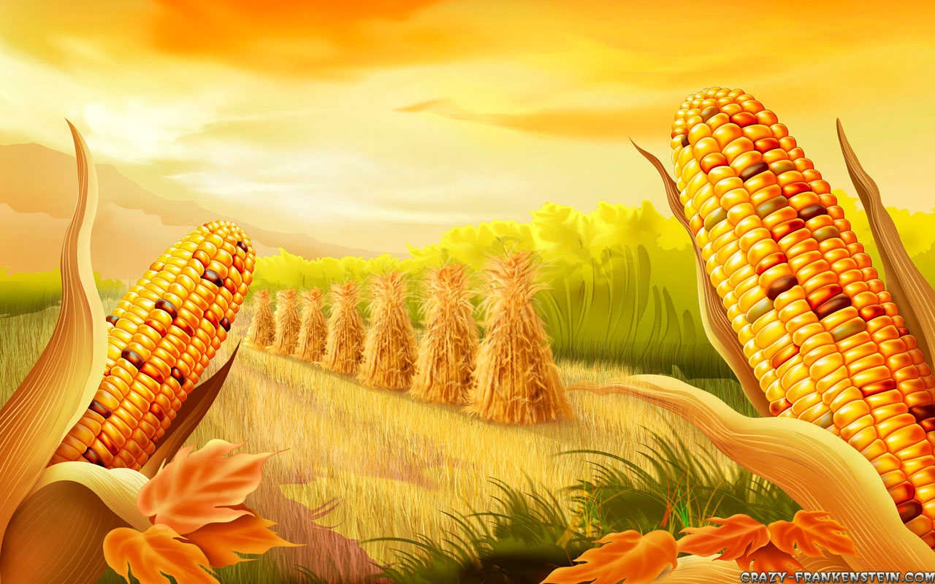
Family and Friends special edition– Grade 4
Many Thanks for your attendants.
Good bye!

